Slide 1
Department of CSE, CSIT
COURSE NAME: Data science
COURSE CODE: 24AD3107
Topic:
Data Pipelines
Session - 6

Slide 2



AIM OF THE SESSION
To familiarize students with the basic concept of Data Pipelines
INSTRUCTIONAL OBJECTIVES
This Session is designed to: Introduction to Data Pipelines
LEARNING OUTCOMES
At the end of this session, you should be able to: basic knowledge of Data Pipelines

Slide 3
Key Concepts
SESSION INTRODUCTION
Data Pipeline Architecture
Pipeline Architecture Importance with An Example
Components and Building Blocks

Slide 4
Data Pipeline Architecture
A Data Pipeline is a series of processes used to collect, transfer, transform, process, and store data from multiple sources into a destination system for analysis and decision-making.
In Data Science, data pipelines automate the flow of data from:
Data sources
to
Storage systems
to
Analytics and Machine Learning models
A data pipeline ensures that data moves smoothly and efficiently through different stages without manual intervention.
Definition of Data Pipeline:
A Data Pipeline is an automated workflow that extracts data from various sources, processes it, and delivers it to a destination for analysis, reporting, or machine learning.

Slide 5
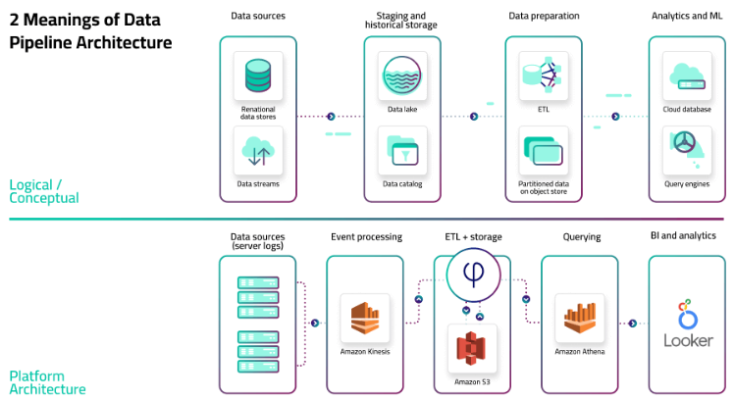
Data Pipeline Architecture
The logical architecture that outlines the process and transformations a dataset undergoes, from collection to serving (see data architecture components).
The specific set of tools and frameworks used in a particular scenario, and the role each of these performs.
Notes:
1. Logical / Conceptual Architecture (Top Part of the Diagram)
This shows how data flows conceptually through different stages:
Data Sources
Relational data stores → databases (like MySQL, PostgreSQL).
Data streams → real-time event data (e.g., IoT sensors, logs, Kafka streams).
Staging and Historical Storage
Data Lake → centralized storage for raw, semi-structured, and structured data.
Data Catalog → metadata system to keep track of what data exists and where.
Data Preparation
ETL (Extract, Transform, Load) → processes raw data into structured/clean data.
Partitioned data on object store → optimized storage format (like Parquet, ORC).
Analytics and Machine Learning (ML)
Cloud database → processed/structured data stored for analysis.
Query engines → tools to analyze/query large datasets (like SQL engines, ML platforms).
🔑 This part is technology-independent and explains the logical flow.
2. Platform Architecture (Bottom Part of the Diagram)
This shows the practical implementation of the logical pipeline using real tools:
Data Sources (server logs)
Logs from servers, applications, APIs, etc.
Event Processing
Amazon Kinesis → streaming service to collect, process, and analyze real-time data.
ETL + Storage
ETL service (symbol φ) → transformation service (could be AWS Glue, Spark, or custom code).
Amazon S3 → object storage where raw + transformed data is stored.
Querying
Amazon Athena → interactive SQL query engine that works directly with S3 data.
BI and Analytics
Looker → business intelligence tool for dashboards, analytics, and reporting.
🔑 This part is technology-specific and shows how the conceptual design is implemented on AWS cloud.

Slide 6
1. Logical / Conceptual Architecture (Top Part of the Diagram)
This shows how data flows conceptually through different stages:
Data Sources
  Relational data stores → databases (like MySQL, PostgreSQL).
  Data streams → real-time event data (e.g., IoT sensors, logs, Kafka streams).
Staging and Historical Storage
  Data Lake → centralized storage for raw, semi-structured, and structured data.
  Data Catalog → metadata system to keep track of what data exists and where.
Data Preparation
  ETL (Extract, Transform, Load) → processes raw data into structured/clean data.
  Partitioned data on object store → optimized storage format (like Parquet, ORC).
Analytics and Machine Learning (ML)
  Cloud database → processed/structured data stored for analysis.
  Query engines → tools to analyze/query large datasets (like SQL engines, ML platforms).
🔑 This part is technology-independent and explains the logical flow.
2. Platform Architecture (Bottom Part of the Diagram)
This shows the practical implementation of the logical pipeline using real tools:
Data Sources (server logs)
  Logs from servers, applications, APIs, etc.
Event Processing
  Amazon Kinesis → streaming service to collect, process, and analyze real-time data.
ETL + Storage
  ETL service (symbol φ) → transformation service (could be AWS Glue, Spark, or custom code).
  Amazon S3 → object storage where raw + transformed data is stored.

Slide 7
Querying
  Amazon Athena → interactive SQL query engine that works directly with S3 data.
BI and Analytics
  Looker → business intelligence tool for dashboards, analytics, and reporting.
🔑 This part is technology-specific and shows how the conceptual design is implemented on AWS cloud.
Summary:
The top part (logical) explains the flow of data: from sources → storage → preparation → analytics.
The bottom part (platform) shows the tools and technologies (like Kinesis, S3, Athena, Looker) that implement the same pipeline in practice

Slide 8
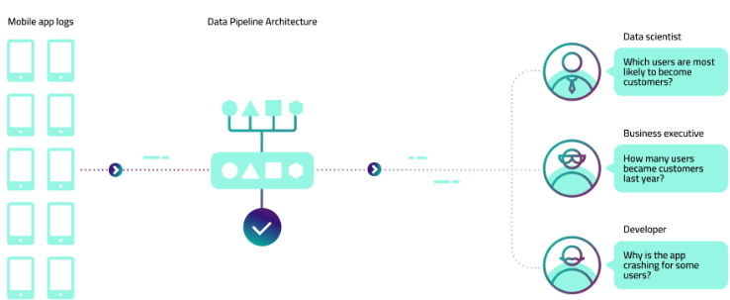
Pipeline Architecture Importance with An Example
Multiple people in the organization will want to work with that data in different ways:
Data scientists want to build models that predict user behavior and to test their hypotheses on various historical states of the data
Developers want to investigate application logs to identify downtime and improve performance
Business executives want visibility into revenue-driving metrics such as installs and in-app purchases
Notes:
Left Side: Data Source
Mobile App Logs
These are raw data generated by users when they interact with a mobile app.
Examples: login attempts, clicks, purchases, crashes, navigation, etc.
🔹 Middle: Data Pipeline Architecture
Data Ingestion
Data from mobile apps is collected into the pipeline.
This step ensures raw logs are captured in real time or batch mode.
Processing & Transformation
The data pipeline processes and transforms data into structured formats.
Example: organizing logs into meaningful events (purchase, crash, active time).
Storage & Validation
The processed data is stored in databases, data warehouses, or data lakes.
It is cleaned, validated, and made ready for analytics.
🔹 Right Side: End Users of Data
The processed data is consumed by different stakeholders, each asking different questions:
Data Scientist
Question: “Which users are most likely to become customers?”
They use statistical models and machine learning to predict future customer behavior.
Business Executive
Question: “How many users became customers last year?”
They focus on business KPIs like conversions, revenue, retention.
This helps in making strategic decisions.
Developer
Question: “Why is the app crashing for some users?”
They analyze error logs and performance metrics to debug issues.

Slide 9
Left Side: Data Source
Mobile App Logs
  These are raw data generated by users when they interact with a mobile app.
  Examples: login attempts, clicks, purchases, crashes, navigation, etc.
Middle: Data Pipeline Architecture
Data Ingestion
  Data from mobile apps is collected into the pipeline.
  This step ensures raw logs are captured in real time or batch mode.
Processing & Transformation
  The data pipeline processes and transforms data into structured formats.
  Example: organizing logs into meaningful events (purchase, crash, active time).
Storage & Validation
  The processed data is stored in databases, data warehouses, or data lakes.
  It is cleaned, validated, and made ready for analytics.
Right Side: End Users of Data
The processed data is consumed by different stakeholders, each asking different questions:
Data Scientist
  Question: “Which users are most likely to become customers?”
  They use statistical models and machine learning to predict future customer behavior.
Business Executive
  Question: “How many users became customers last year?”
  They focus on business KPIs like conversions, revenue, retention.
  This helps in making strategic decisions.
Developer
  Question: “Why is the app crashing for some users?”
  They analyze error logs and performance metrics to debug issues.

Slide 10
Components and Building Blocks
This includes:
Collection: Source data is generated from remote devices, applications, or business systems, and made available via API.
Ingestion: Collected data is moved to a storage layer where it can be further prepared for analysis. The storage layer might be a relational database like MySQL or unstructured object storage in a cloud data lake such as AWS S3.
Preparation: Data is aggregated, cleansed, and manipulated in order to normalize it to company standards and make it available for further analysis. This could also include converting file formats, compressing and partitioning data.
Consumption: Prepared data is moved to production systems – analytics and visualization tools, operational data stores, decision engines, or user-facing applications.

Slide 11
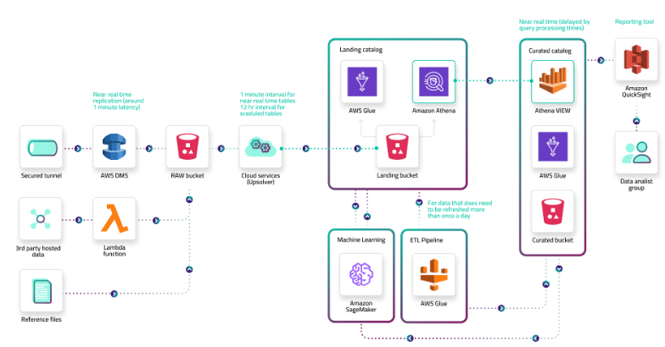
Components and Building Blocks
Notes:
Data Ingestion (Input Layer)
Secured tunnel – A secure connection is established for data transfer.
AWS DMS (Database Migration Service) – Moves data from on-premises or external databases into AWS.
R/M bucket (likely Raw/Managed S3 bucket) – Stores the raw incoming data.
Cloud servers / Edge devices – Data can also arrive from IoT devices, web apps, or servers.
3rd party hosted / Reference files – External data sources or static files also get ingested.
Lambda functions – Perform lightweight, serverless transformations or triggers before storing data
Landing Zone (Staging Layer)
Data lands in a Landing Catalog using:
AWS Glue – Catalogs metadata and prepares data for queries.
Amazon Athena – A query service that analyzes data directly in S3 without moving it.
Purpose: Prepare the data for cleaning, transformation, or further processing.
Processing (Transformation & Enrichment)
Machine Learning (Amazon SageMaker)
Uses ML models to enrich the data (e.g., predictions, anomaly detection).
ETL Pipeline (AWS Glue)
Extract, Transform, Load process: cleans, transforms, and structures data for analytics.
Curated Zone (Organized Data Layer)
Data that is cleaned, validated, and transformed is stored in the Curated Catalog.
Tools used:
Athena Views – Enables querying of curated datasets.
AWS Glue – Maintains metadata and schema definitions.
Curated bucket (S3) – Stores transformed datasets.
Reporting & Analytics (Output Layer)
Amazon QuickSight – Visualization and reporting tool.
Data Analytics Group – End users or analysts consume the insights from curated datasets.
End-to-End Flow
👉 Raw data (secured tunnel, DMS, Lambda, external sources)
➡ Stored in S3 raw bucket
➡ Metadata + structure defined in AWS Glue
➡ Query with Athena
➡ Process/enrich with ETL & SageMaker
➡ Store in Curated Catalog
➡ Query & visualize with Athena Views + QuickSight
➡ Used by Analytics teams.

Slide 12
This diagram represents a data lake architecture on AWS, where:
Raw data enters via multiple sources.
It is stored, cataloged, and transformed.
Machine learning & ETL pipelines enrich the data.
Curated datasets are created for reliable analytics.
Finally, business intelligence tools (QuickSight) help visualize insights.

Slide 13
Data Ingestion (Input Layer)
Secured tunnel – A secure connection is established for data transfer.
AWS DMS (Database Migration Service) – Moves data from on-premises or external databases into AWS.
R/M bucket (likely Raw/Managed S3 bucket) – Stores the raw incoming data.
Cloud servers / Edge devices – Data can also arrive from IoT devices, web apps, or servers.
3rd party hosted / Reference files – External data sources or static files also get ingested.
Lambda functions – Perform lightweight, serverless transformations or triggers before storing data
Landing Zone (Staging Layer)
Data lands in a Landing Catalog using:
  AWS Glue – Catalogs metadata and prepares data for queries.
  Amazon Athena – A query service that analyzes data directly in S3 without moving it.
Purpose: Prepare the data for cleaning, transformation, or further processing.
Processing (Transformation & Enrichment)
Machine Learning (Amazon SageMaker)
  Uses ML models to enrich the data (e.g., predictions, anomaly detection).
ETL Pipeline (AWS Glue)
  Extract, Transform, Load process: cleans, transforms, and structures data for analytics.
Curated Zone (Organized Data Layer)
Data that is cleaned, validated, and transformed is stored in the Curated Catalog.
Tools used:
  Athena Views – Enables querying of curated datasets.
  AWS Glue – Maintains metadata and schema definitions.
  Curated bucket (S3) – Stores transformed datasets.
Reporting & Analytics (Output Layer)
Amazon QuickSight – Visualization and reporting tool.
Data Analytics Group – End users or analysts consume the insights from curated datasets.
End-to-End Flow
👉 Raw data (secured tunnel, DMS, Lambda, external sources)
➡ Stored in S3 raw bucket
➡ Metadata + structure defined in AWS Glue
➡ Query with Athena
➡ Process/enrich with ETL & SageMaker
➡ Store in Curated Catalog
➡ Query & visualize with Athena Views + QuickSight
➡ Used by Analytics teams.

Slide 14
Similarity and Dissimilarity
In Data Science, Machine Learning, Data Mining, and Pattern Recognition, it is often necessary to compare objects, records, or datasets to determine how similar or different they are.
This comparison is done using:
Similarity Measures
Dissimilarity Measures
Similarity and dissimilarity are widely used in:
Recommendation systems
Clustering
Classification
Image recognition
Text mining
Healthcare analytics

Slide 15
Similarity
Definition
Similarity refers to the degree to which two objects, records, or data points are alike.
If two objects are highly similar:
Their characteristics are nearly the same.
Their similarity value is high.
Example: Two students with similar:
Marks
Attendance
Study behavior
are considered similar.

Slide 16
Similarity Scale
Usually:
Higher value → More similar
Lower value → Less similar
Most similarity measures range between: 0 and 1 Where:
1 → Completely similar
0 → Completely different

Slide 17
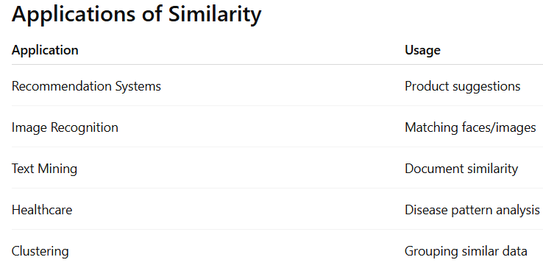
Real-Time Example of Similarity: E-Commerce Recommendation System
Amazon compares customers based on:
Purchase history
Browsing behavior
Product ratings
If two customers have similar interests, Amazon recommends similar products.

Slide 18
Dissimilarity
Definition
Dissimilarity refers to the degree to which two objects differ from each other.
If two objects are very different:
Their dissimilarity value is high.
Example
Two patients with completely different symptoms have high dissimilarity.
Dissimilarity Scale
Usually:
Higher value → More different
Lower value → More similar

Slide 19
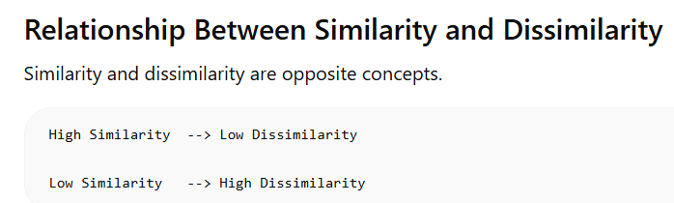
Real-Time Example: Fraud Detection
Banks compare transaction patterns.
If a transaction is highly dissimilar from normal customer behavior:
It may be flagged as fraudulent.

Slide 20
Distance Measures for Numerical Data
Distance Measures for Numerical Data
Euclidean Distance: It is the straight-linei distance between two points in space.
√[(x1-y1)² + (x2-y2)² + ... + (xn-yn)²]
Manhattan Distance:It sums the absolute differences along each dimension. |x1-y1| + |x2-y2| + ... + |xn-yn|
Minkowski Distance: Generalization of Euclidean and Manhattan

Slide 21
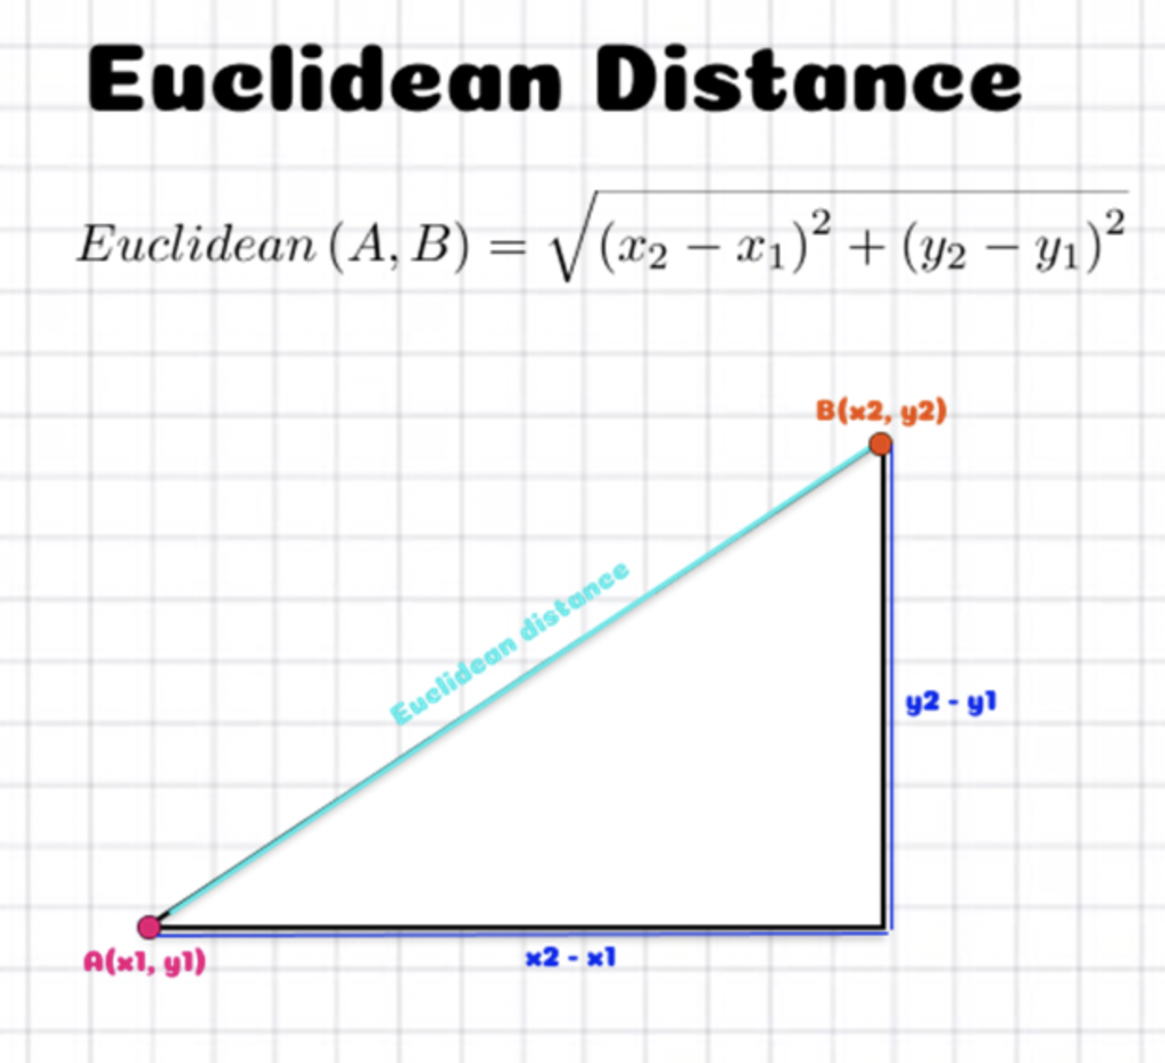

Slide 22
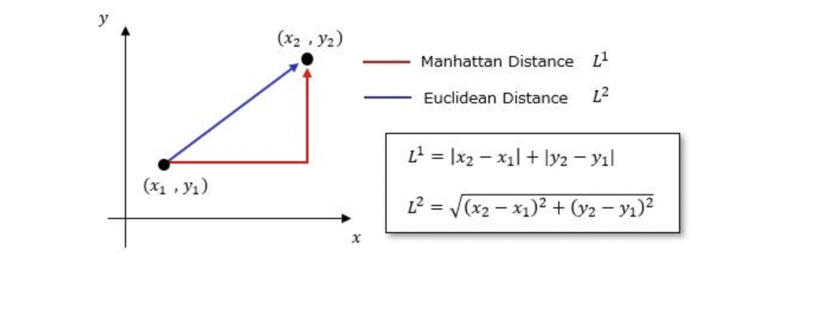
Manhattan Distance

Slide 23
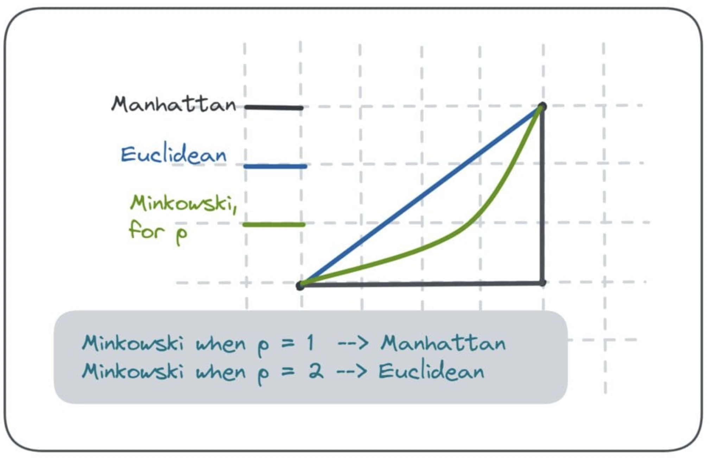

Slide 24
Similarity Measures for Text or Binary Data
Similarity Measures for Text or Binary Data
Cosine Similarity: Measures angle between two vectors (used in text)
Jaccard Similarity: Intersection / Union (used for binary/categorical)
Hamming Distance: Number of positions with different values

Slide 25
Cosine Similarity
Cosine similarity is a measure of similarity between two non-zero vectors of an inner product space that measures the cosine of the angle between them. Similarity = (A.B) / (||A||.||B||) where A and B are vectors.
Example :
Text A: "Data science is fun and"
Text B: "Machine learning is cool and"

Slide 26
Represent as Vectors (Bag-of-Words)
Word | Text A (Vector A) | Text B (Vector B)
data | 1 | 0
science | 1 | 0
is | 1 | 1
fun | 1 | 0
and | 1 | 1
machine | 0 | 1
learning | 0 | 1
cool | 0 | 1

Slide 27
So the vectors are:
Vector A: [1, 1, 1, 1, 1, 0, 0, 0]
Vector B: [0, 0, 1, 0, 1, 1, 1, 1]

Slide 28
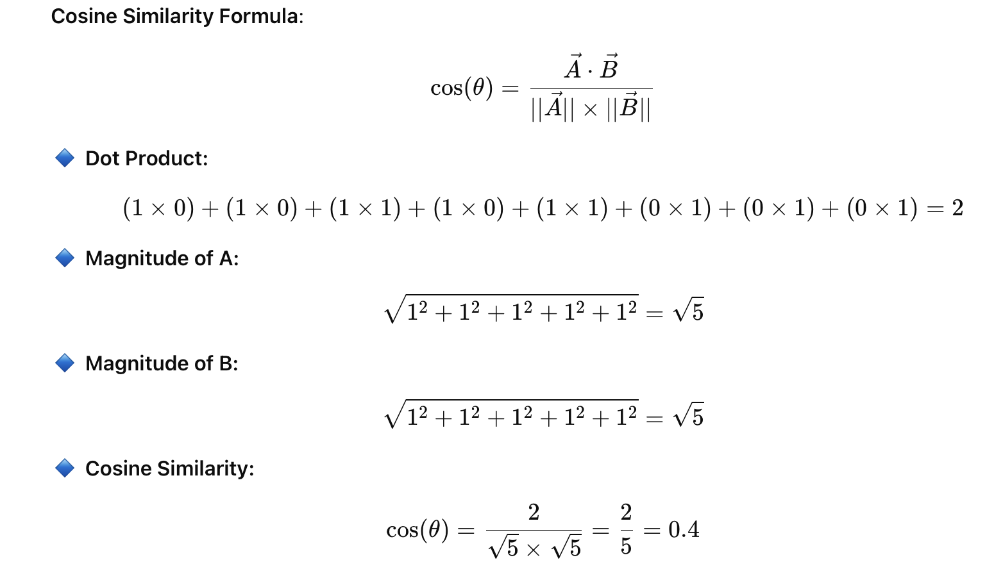
Compute Cosine Similarity

Slide 29
Result
Cosine Similarity = 0.4 (on a scale of 0 to 1)
This indicates some similarity, mainly due to shared words like "is" and "and".

Slide 30
Let’s now compute Jaccard Similarity using the same two 5-word texts.
Example Texts (5 words each):
Text A: "Data science is fun and"
Text B: "Machine learning is cool and"

Slide 31
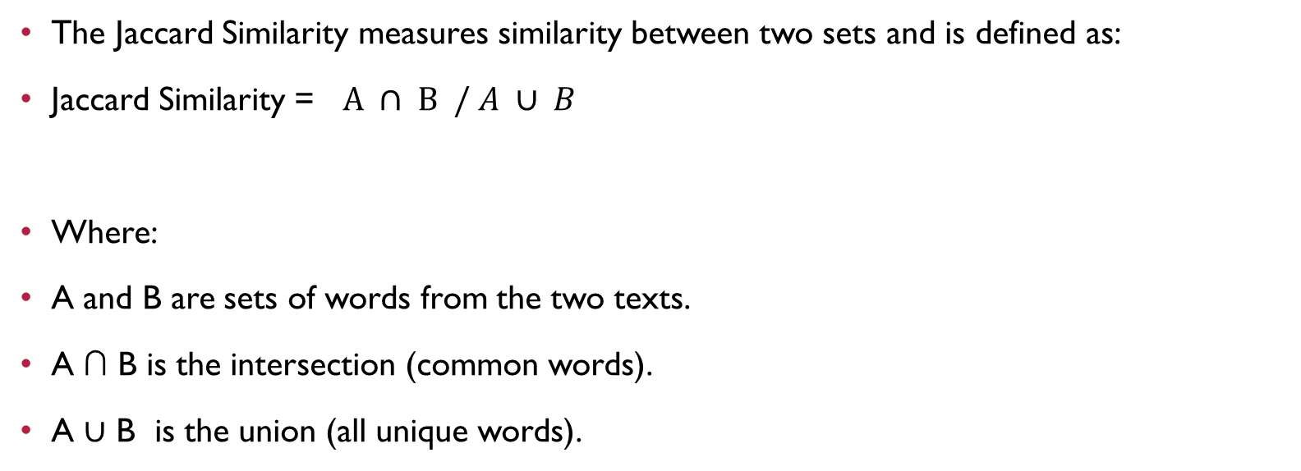
What is Jaccard Similarity?
The Jaccard Similarity measures similarity between two sets and is defined as:
Jaccard Similarity = $A ∩ B / A ∪ B$
Where:
A and B are sets of words from the two texts.
A ∩ B is the intersection (common words).
A ∪ B is the union (all unique words).

Slide 32
Computation
Step 1: Convert to Sets
Set A: {data, science, is, fun, and}
Set B: {machine, learning, is, cool, and}
Step 2 :Compute Intersection and Union
Intersection: {is, and} → 2 words
Union: {data, science, is, fun, and, machine, learning, cool} → 8 words

Slide 33
Step 3 : Compute
Jaccard Similarity = 8/2 =0.25
Final Result
Jaccard Similarity = 0.25
It shows that the sets share 25% common words.

Slide 34
Hamming distance
Definition:
Hamming distance measures the number of positions at which two equal-length objects differ.
👉 It is mainly used for:
Binary data (0/1)
Categorical data
Error detection in coding systems

Slide 35
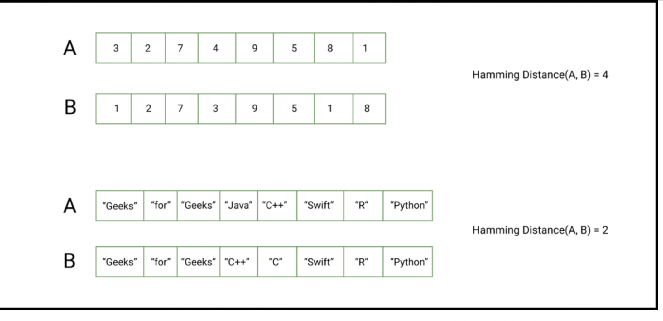
Example: Hamming distance between two vectors

Slide 36
Applications of Hamming Distance
Application Area | Use Case
Error detection & correction | Used in Hamming codes to detect and correct single-bit errors in data transmission.
Networking | To verify data integrity in communication systems.
Genetics/Bioinformatics | Compare DNA sequences to identify mutations.
Cryptography | Compare encrypted hashes for similarity.
Machine Learning | Distance metric in binary feature vectors (e.g., in k-NN or clustering).

Slide 37

THANK YOU
Team – DS

